Slide 1
Beyond Task-Optimized Neural Models: Constraints From Embodied Cognition
KAUSHIK LAKSHMINARASIMHAN
Columbia University

Slide 2

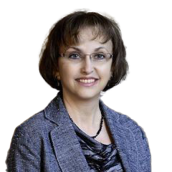
AKIS STAVROPOULOS
NYU
DORA ANGELAKI
NYU

Slide 3

AKIS STAVROPOULOS
NYU
DORA ANGELAKI
NYU
XAQ PITKOW
Rice

Slide 4
Beyond Task-Optimized Neural Models: Constraints From Embodied Cognition
Notes:
The question I set out to answer is aligned with the spirit of GAC-1 which is “how do we build better neural models of the brain?”. There seemed to be some consensus about the need to go beyond… by incorporating additional constraints such biophysically realistic neurons for instance.

Slide 5
How?
Beyond Task-Optimized Neural Models: Constraints From Embodied Cognition
Notes:
What I hope to show is that one can also get useful constraints from behavior itself provided the task is rich enough. Why do I say that?

Slide 6
Task-optimized modeling approach
BRAIN
1
Pick a task for the brain to solve
Observe
Act

Slide 7
Task-optimized modeling approach
BRAIN
1
Pick a task for the brain to solve
Observe
Act
2
Build a model that solves same task
MODEL
Observe
Act

Slide 8
Task-optimized modeling approach
BRAIN
1
Pick a task for the brain to solve
Observe
Act
2
Build a model that solves same task
Correlated ?
3
Compare internal representations
MODEL
Observe
Act

Slide 9
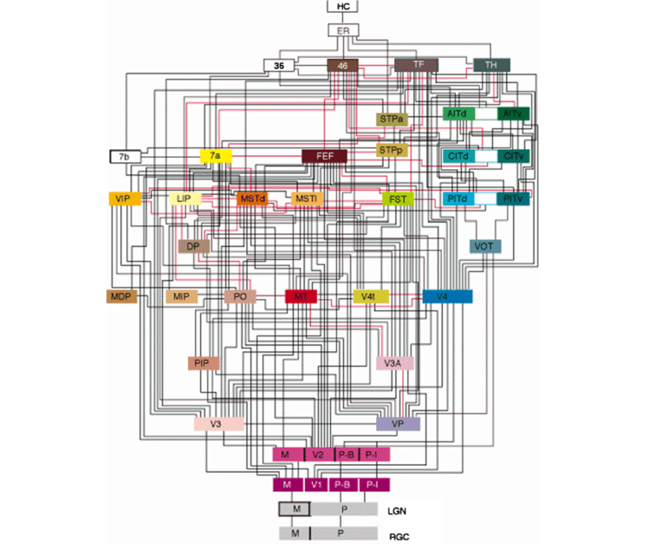
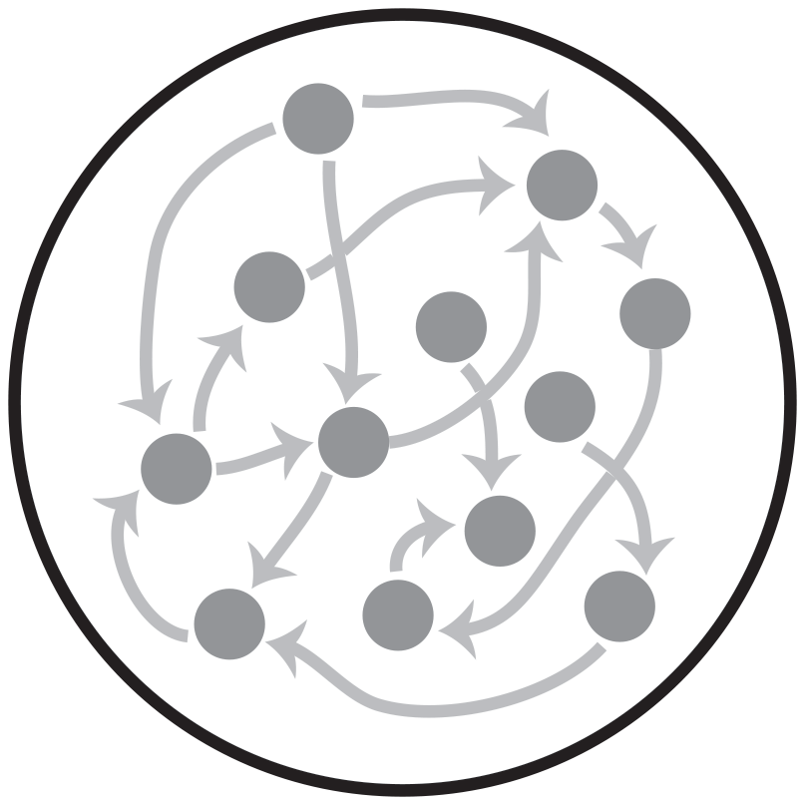
1
Pick a task for the brain to solve
Observe
Act
2
Build a model that solves same task
Correlated ?
3
Compare internal representations
Observe
Act
Notes:
Mention eye movement

Slide 10
WORLD
BRAIN
1
Pick a task for the brain to solve
State
Observe
Act
2
Build a model that solves same task
Correlated ?
Belief
3
Compare internal representations
MODEL
“Ask not What’s Inside your Head, but What your Head is Inside of ”
William Mace, 1977
Observe
Act
What your Head is Inside of
Notes:
Embodied cognition – mention that still okay to look inside the brain

Slide 11
WORLD
State
1
Pick a naturalistic task for the brain to solve
2
Build a model that solves same task
using a similar strategy
BRAIN
Observe
Act
Belief
3
Compare internal representations
“Ask not What’s Inside your Head, but What your Head is Inside of ”
William Mace, 1977
Notes:
Finish intro in 3 mins or so

Slide 12
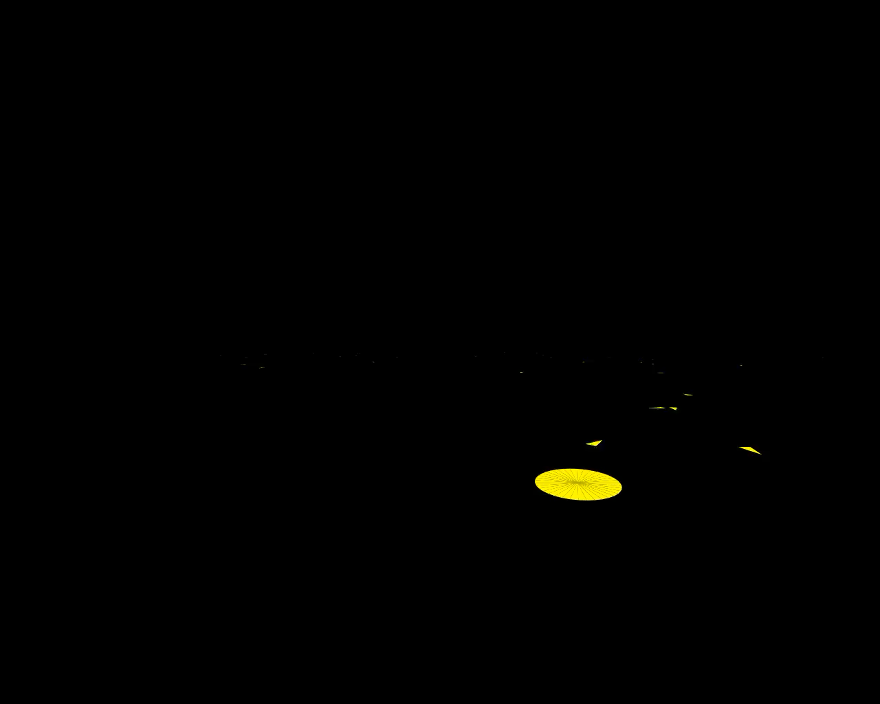
Target appears only briefly
Use joystick to control 2D movement velocity
Stop at the target location to get reward
No landmarks, so navigate by integrating self-motion
Free eye movements
Notes:
We designed a naturalistic task…
a Virtual-reality based spatial navigation task that we asked both humans and monkeys to do
Video that shows a series of 5 trials…
Monkeys get rewarded for correctly stopping at the remembered goal location

Slide 13
Target appears only briefly
Use joystick to control 2D movement velocity
Stop at the target location to get reward
No landmarks, so navigate by integrating self-motion
Free eye movements
Opportunity to interact with the world in a natural way
Opportunity to gain more information about their beliefs

Slide 14
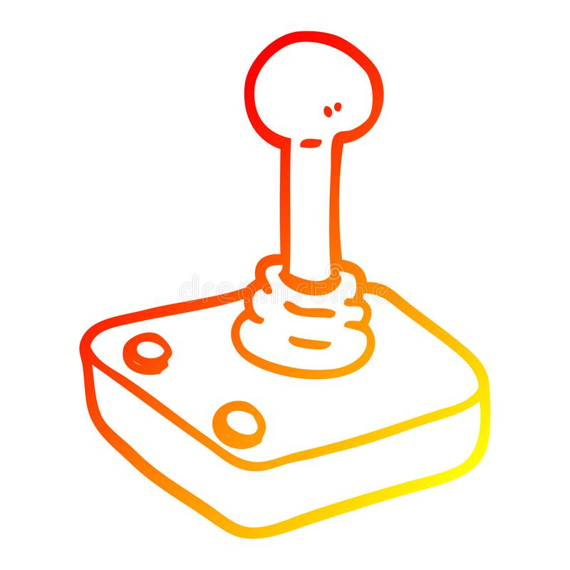

Task performance
1m
1m

Slide 15
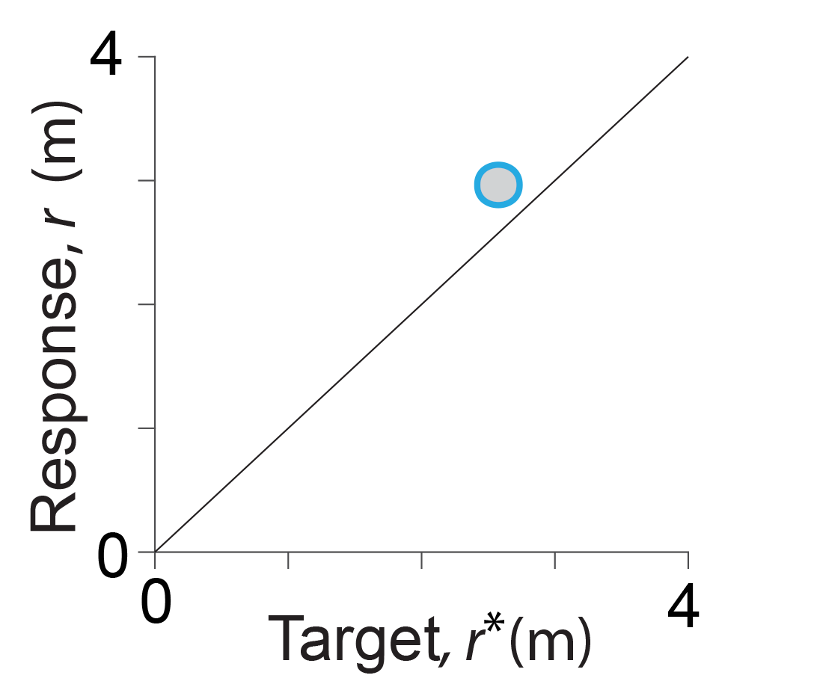
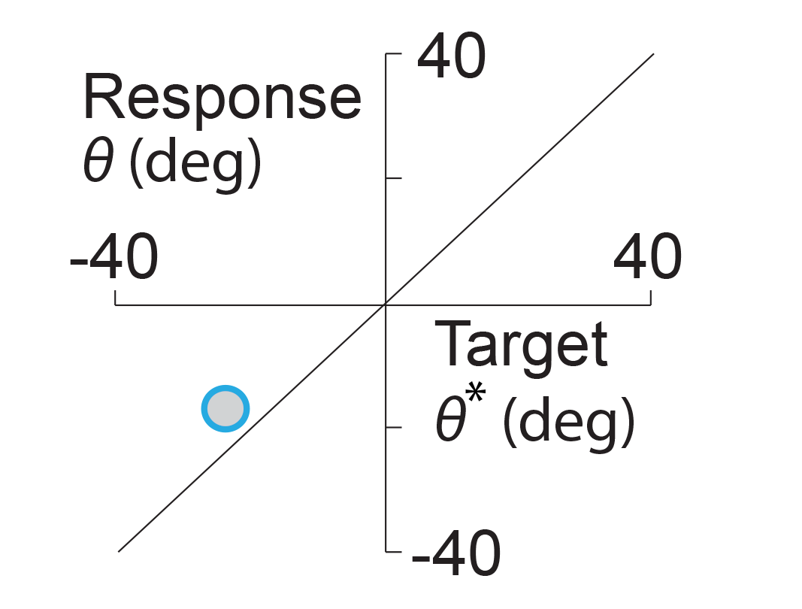
Task performance
1m
1m

Slide 16
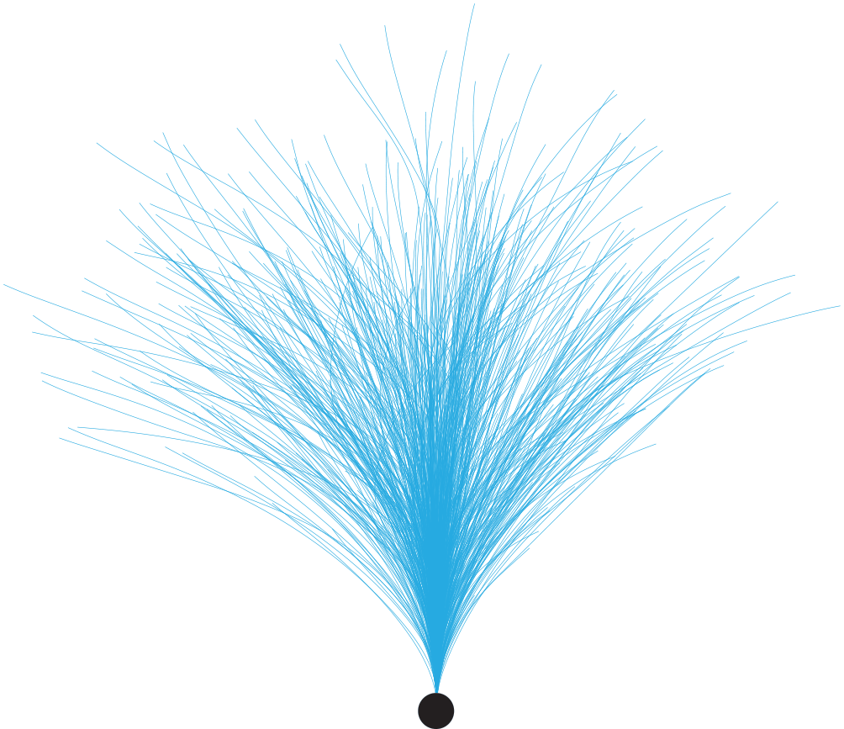
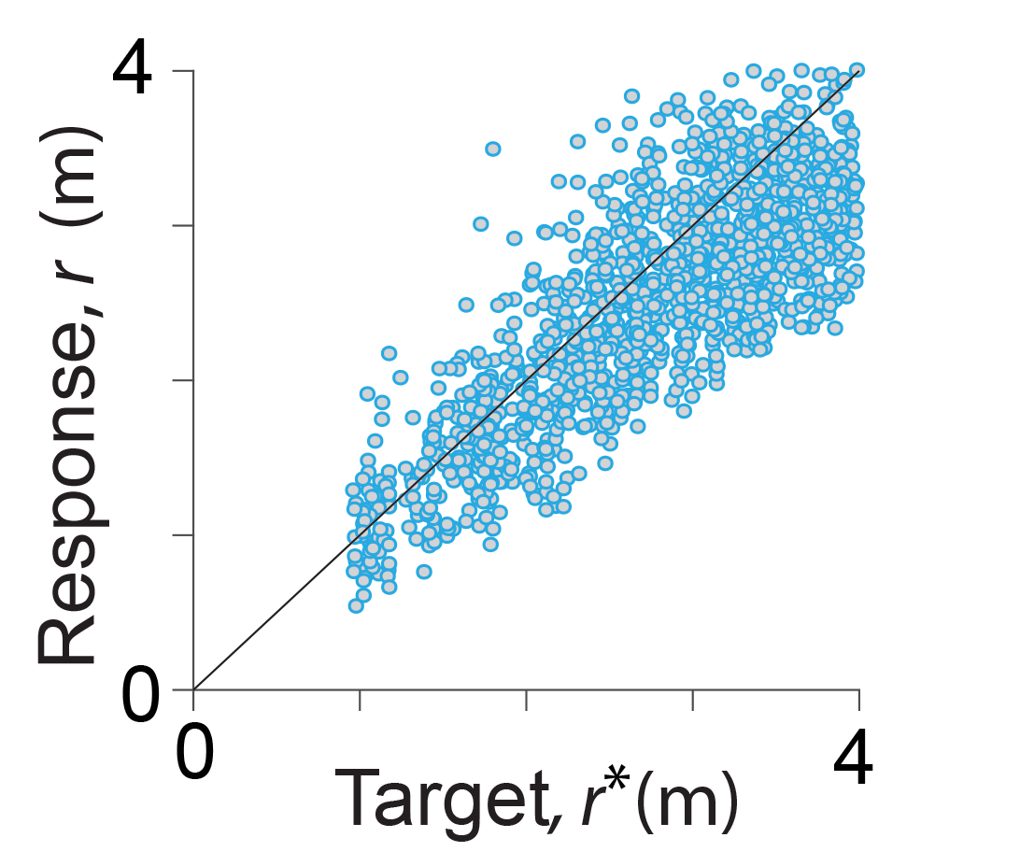
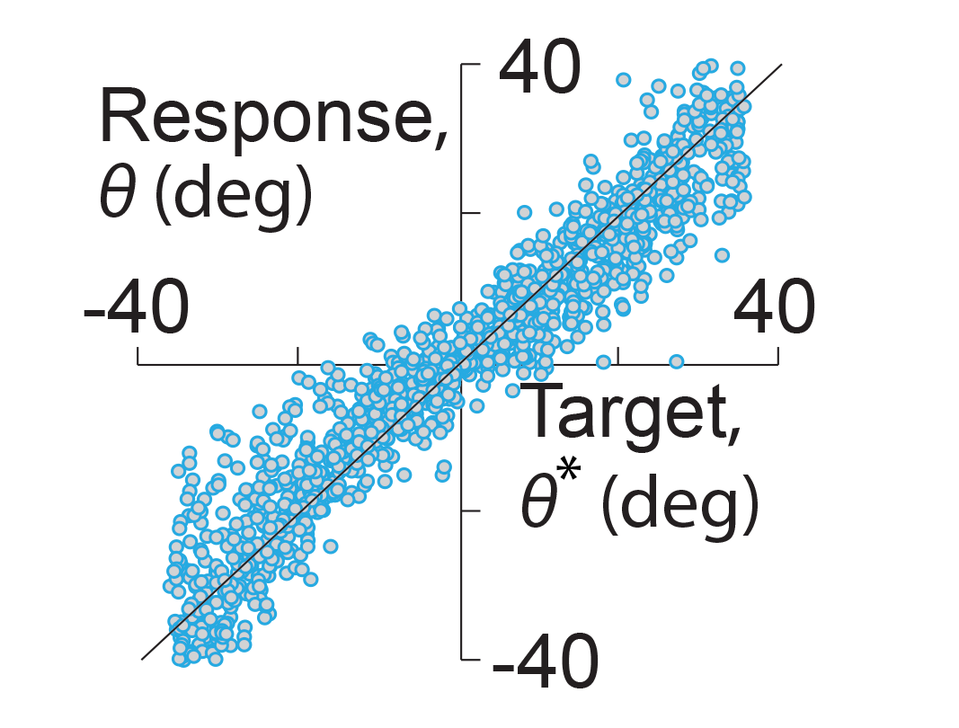

Task performance
1m
1m

Slide 17
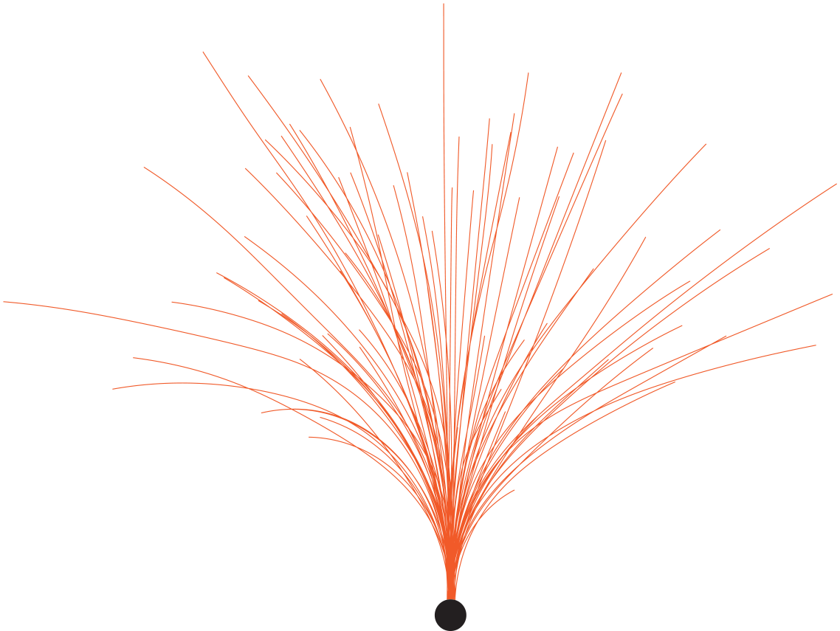
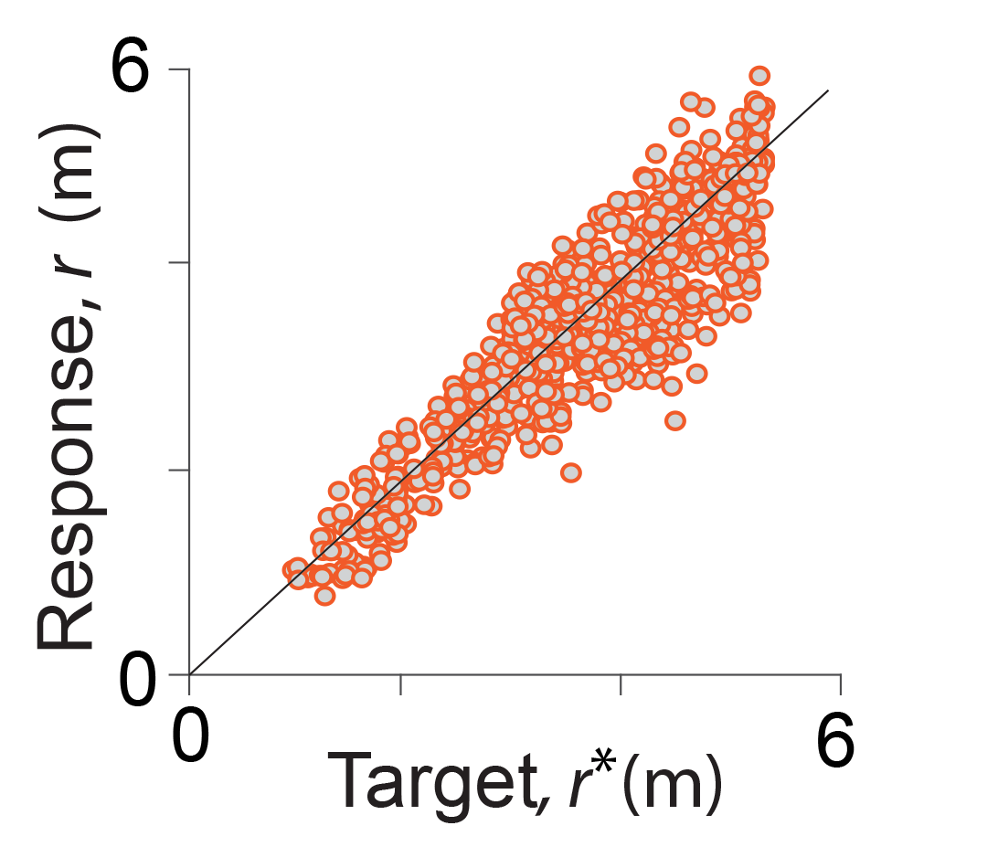
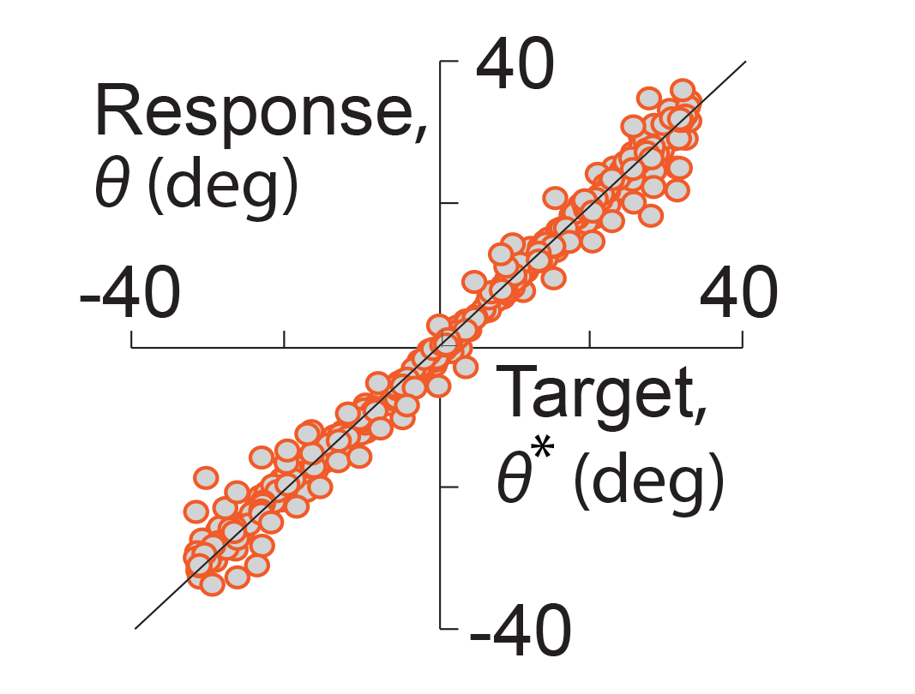

Task performance
1m
1m

Slide 18

Behavioral strategy

Slide 19
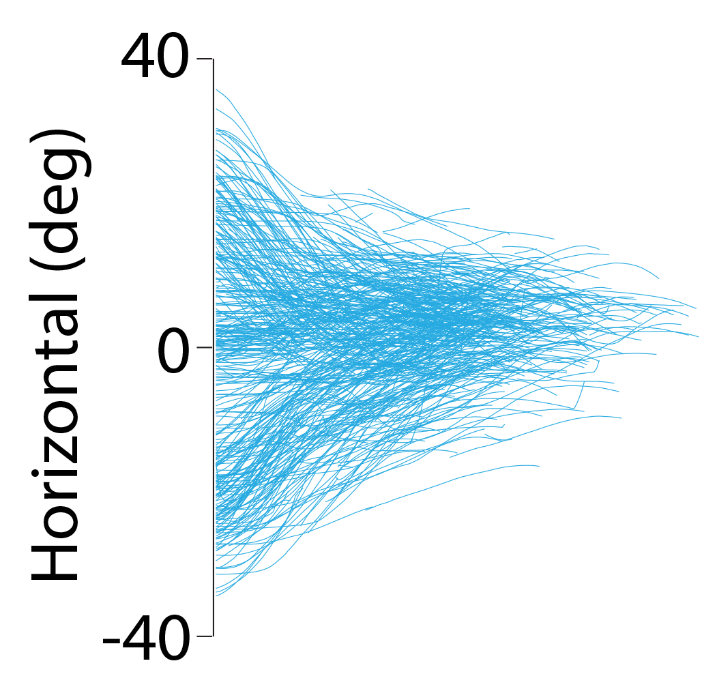
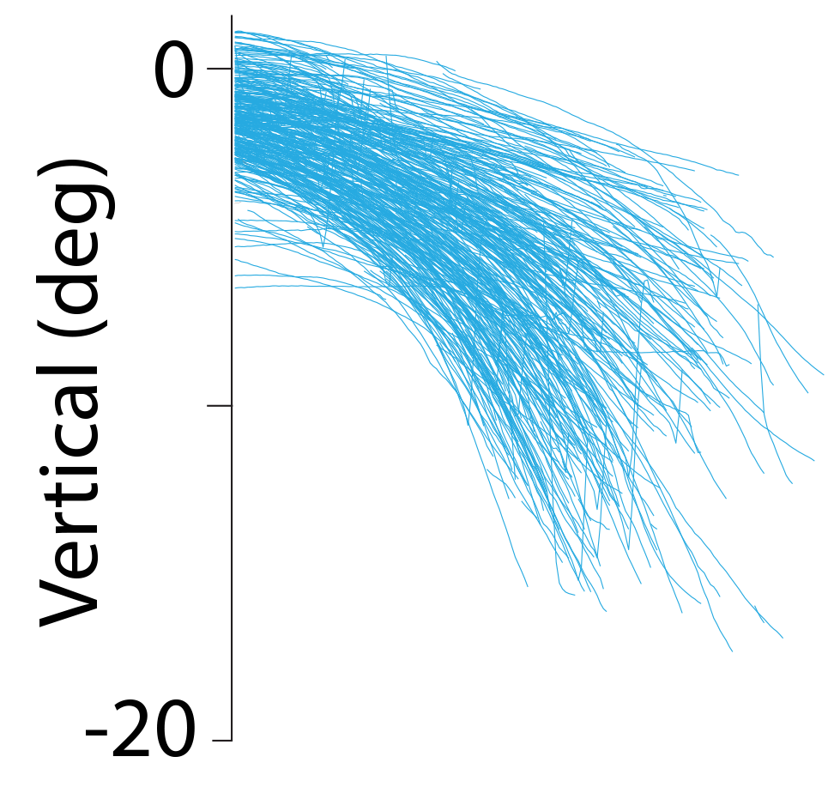
Behavioral strategy
1s

Slide 20
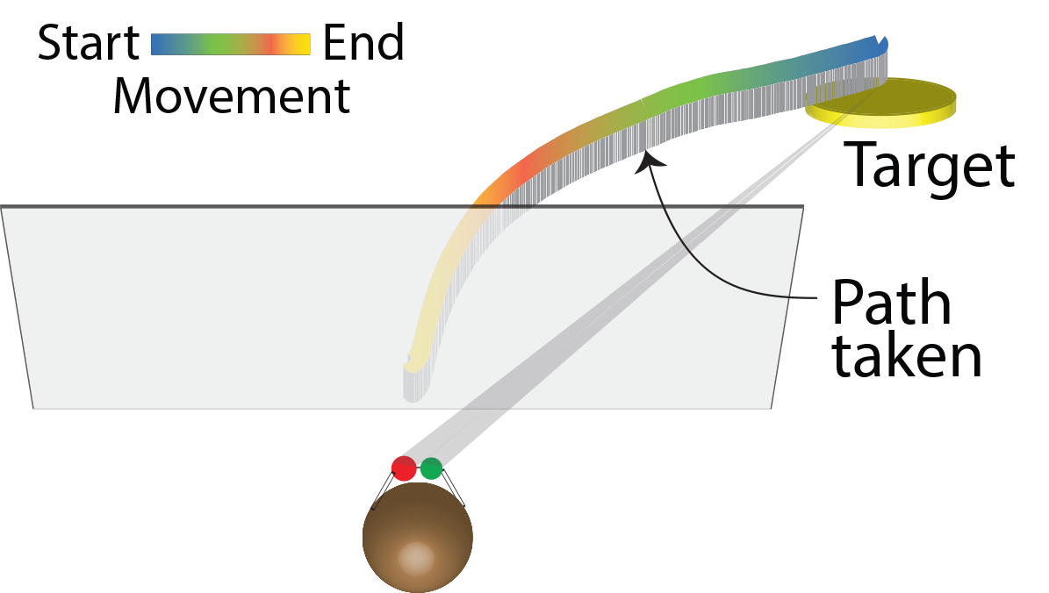
Behavioral strategy
1s
0
0

Slide 21
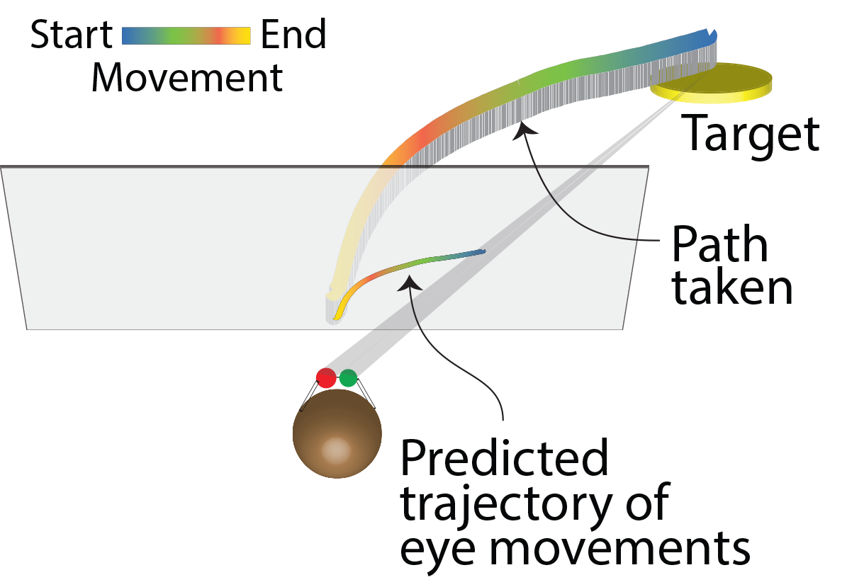
Behavioral strategy
1s
0
0

Slide 22
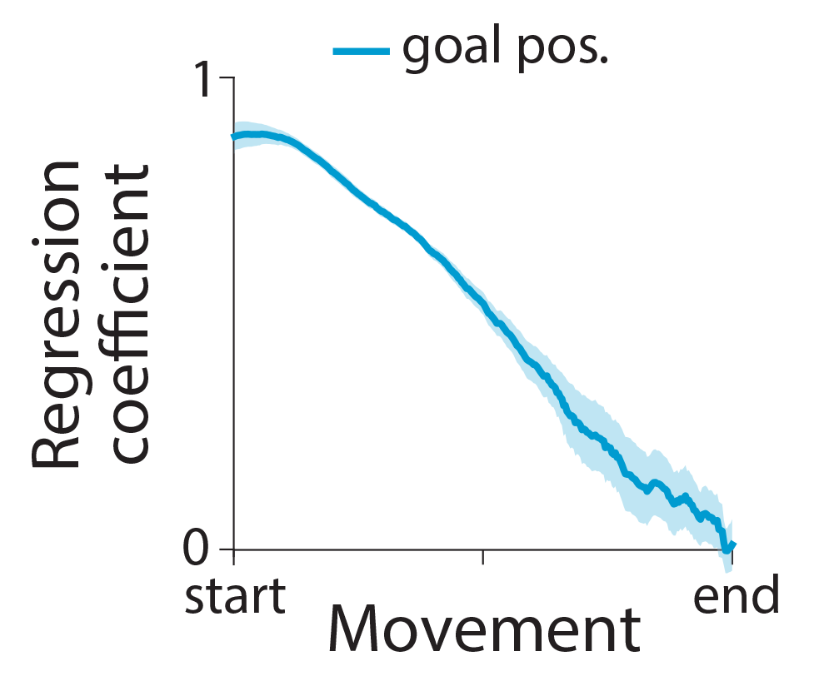
Behavioral strategy
1s

Slide 23
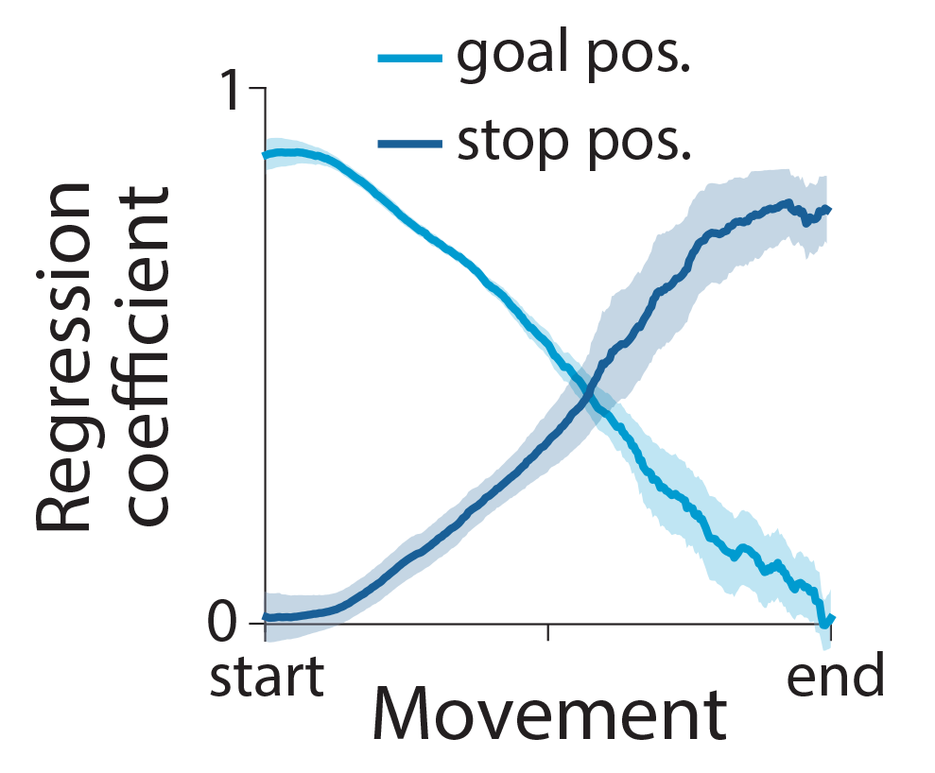
Behavioral strategy
1s
Notes:
Bottom right plot y-axis

Slide 24
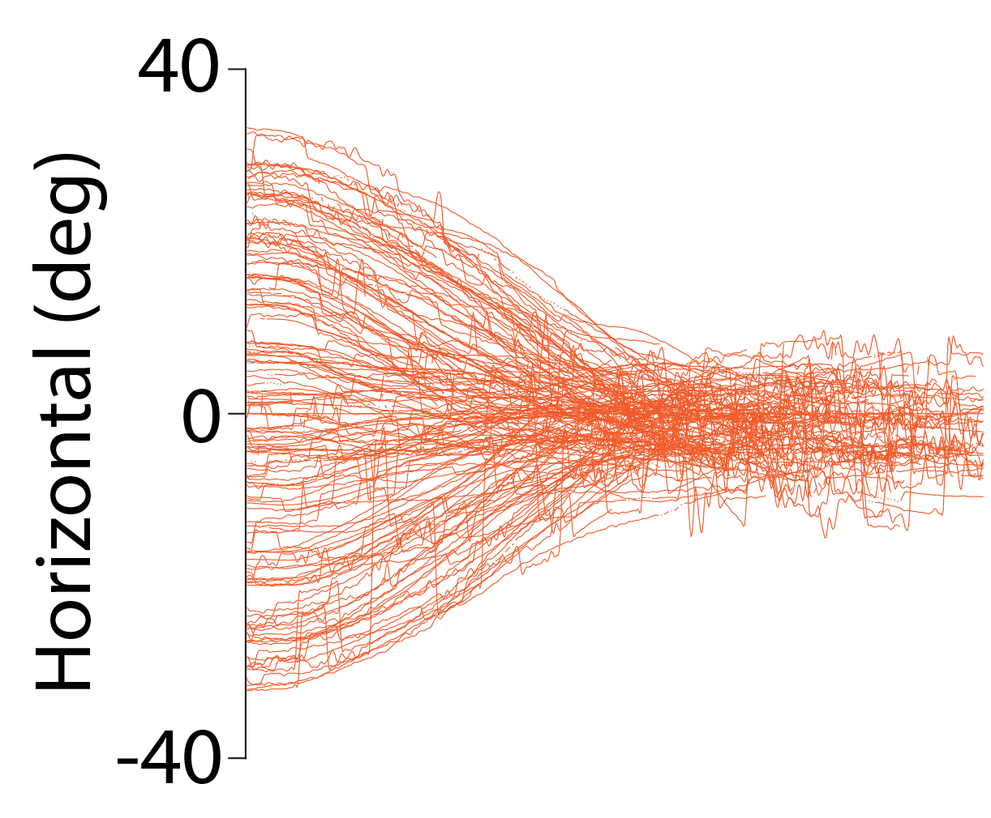
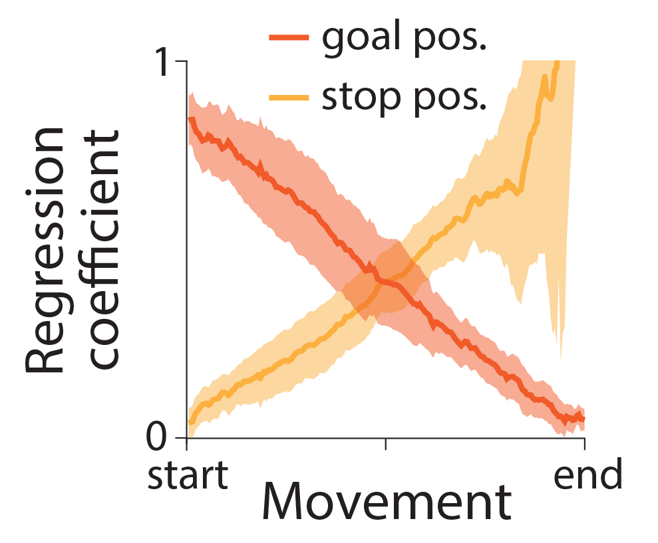
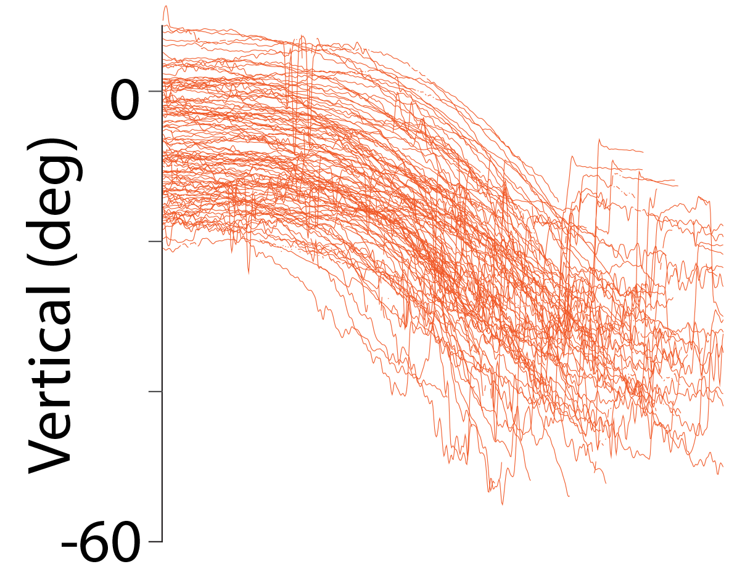
Behavioral strategy
1s
Notes:
Bottom right plot y-axis

Slide 25
Behavioral strategy
Belief about the target location is embodied in eye movements

Slide 26
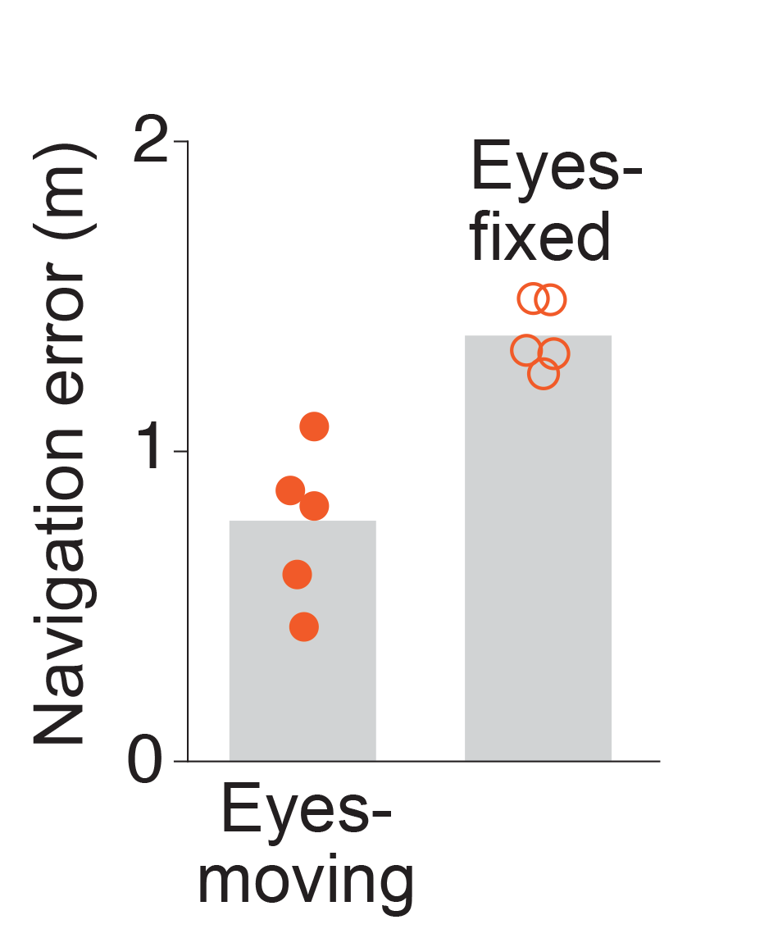
Behavioral strategy
Belief about the target location is embodied in eye movements
Embodiment supports task performance

Slide 27
Why is embodiment useful?
Belief about the target location is embodied in eye movements
Embodiment supports task performance

Slide 28
Why is embodiment useful?
WORLD
INFER
VELOCITY
INTEGRATE
Observe
Act

Slide 29
Why is embodiment useful?
WORLD
INFER
VELOCITY
INTEGRATE
Observe
Act

Slide 30
Why is embodiment useful?
WORLD
INFER
VELOCITY
INTEGRATE
Observe
Act
Notes:
Process optic flow
Reduce working memory burden

Slide 31
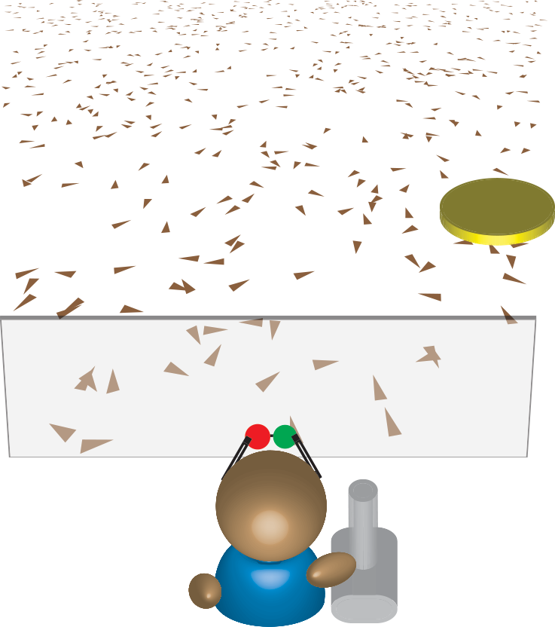
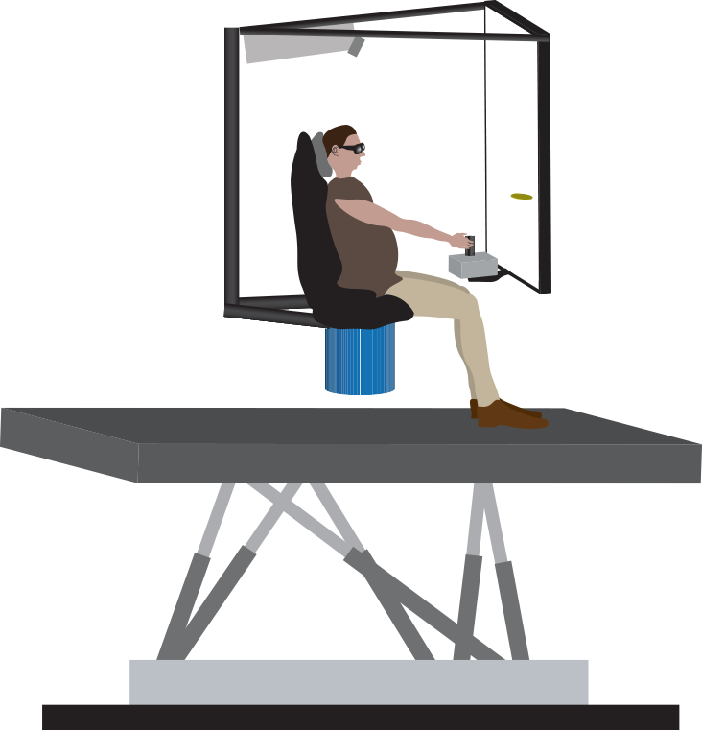
Visual cues
Vestibular cues

Slide 32
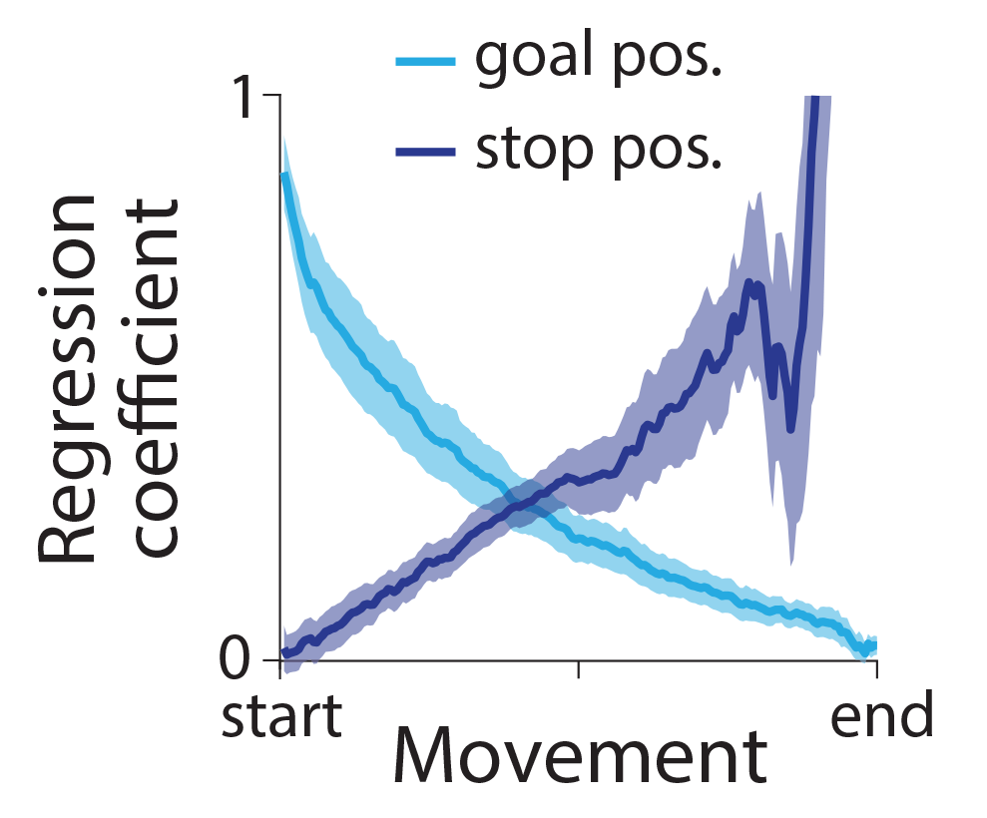
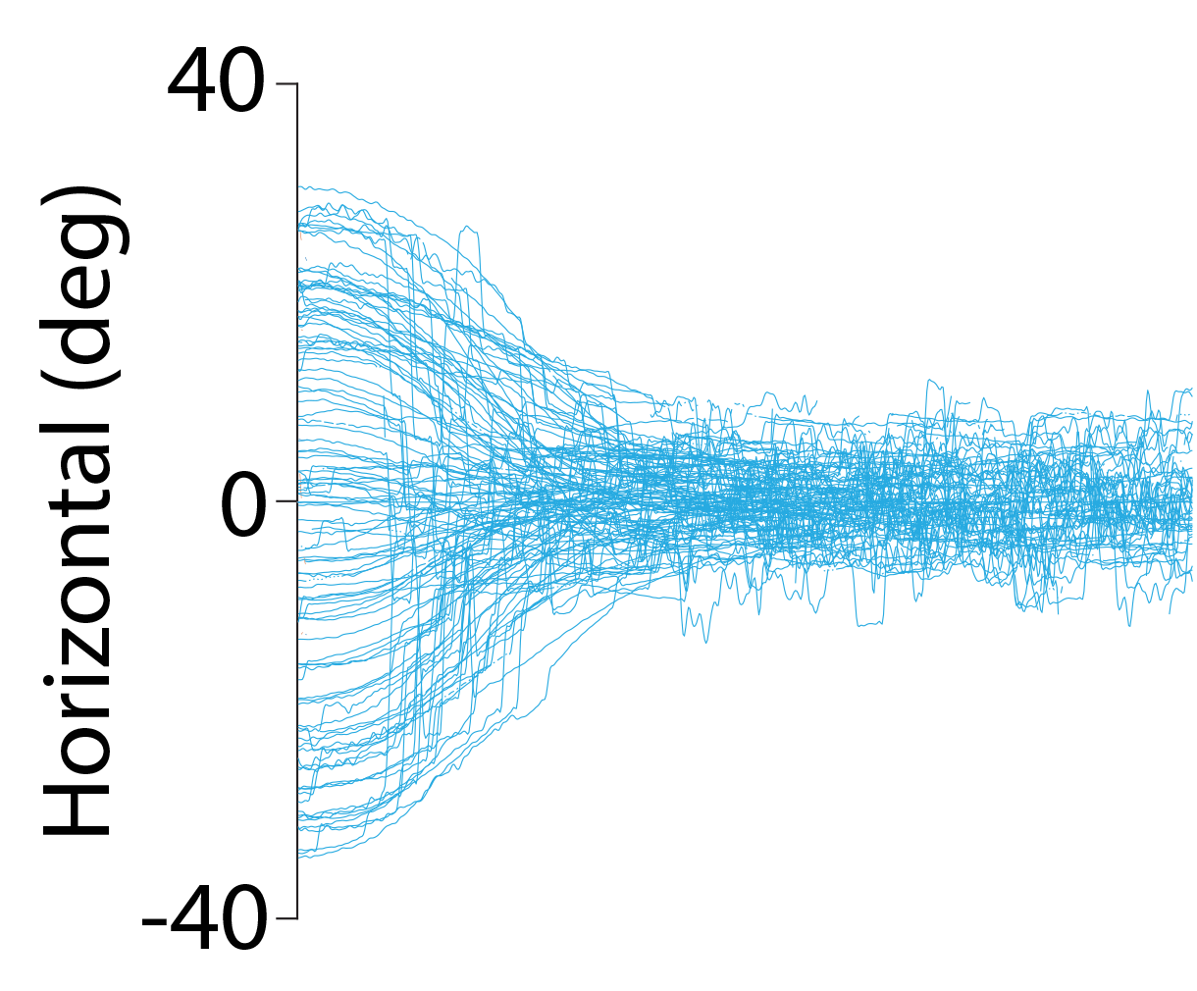
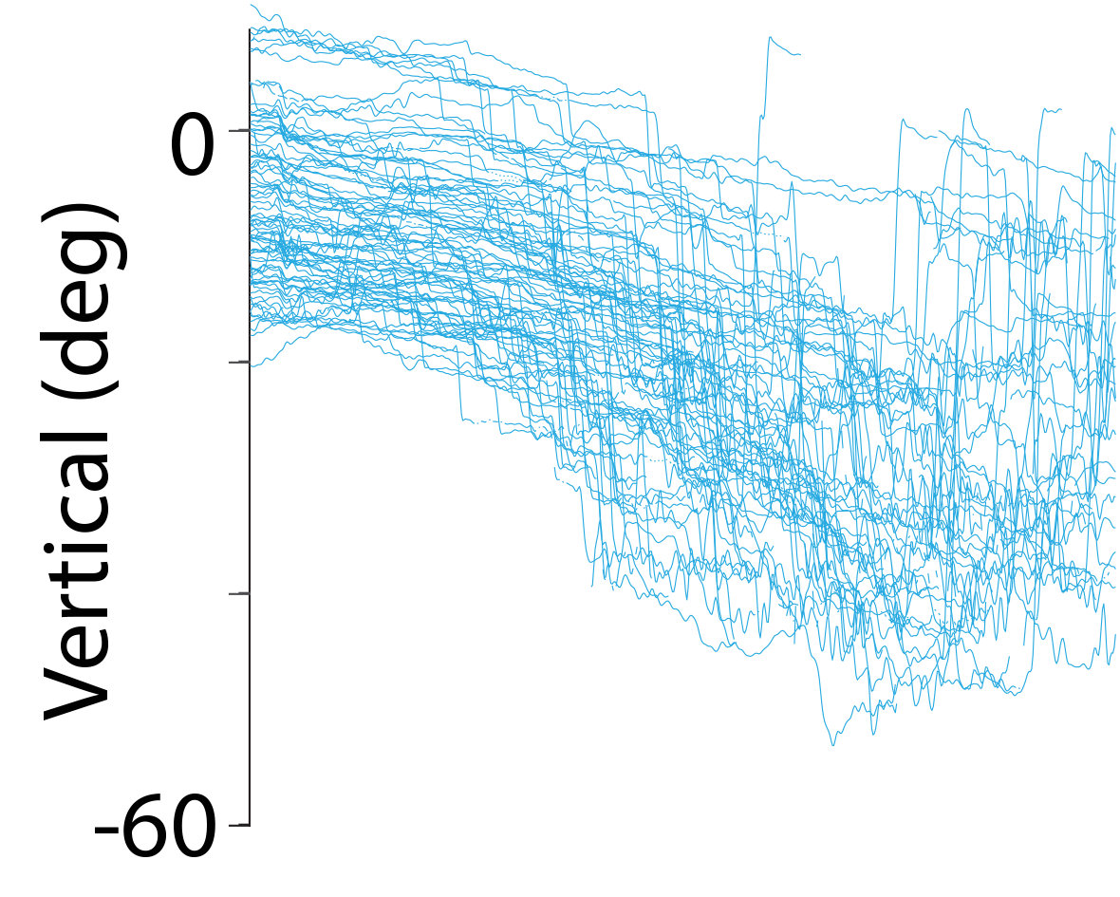

Slide 33
Why is embodiment useful?
WORLD
✓
INFER
VELOCITY
INTEGRATE
Observe
Act
Notes:
Regardless of the format of observations, beliefs are embodied in eye movements

Slide 34
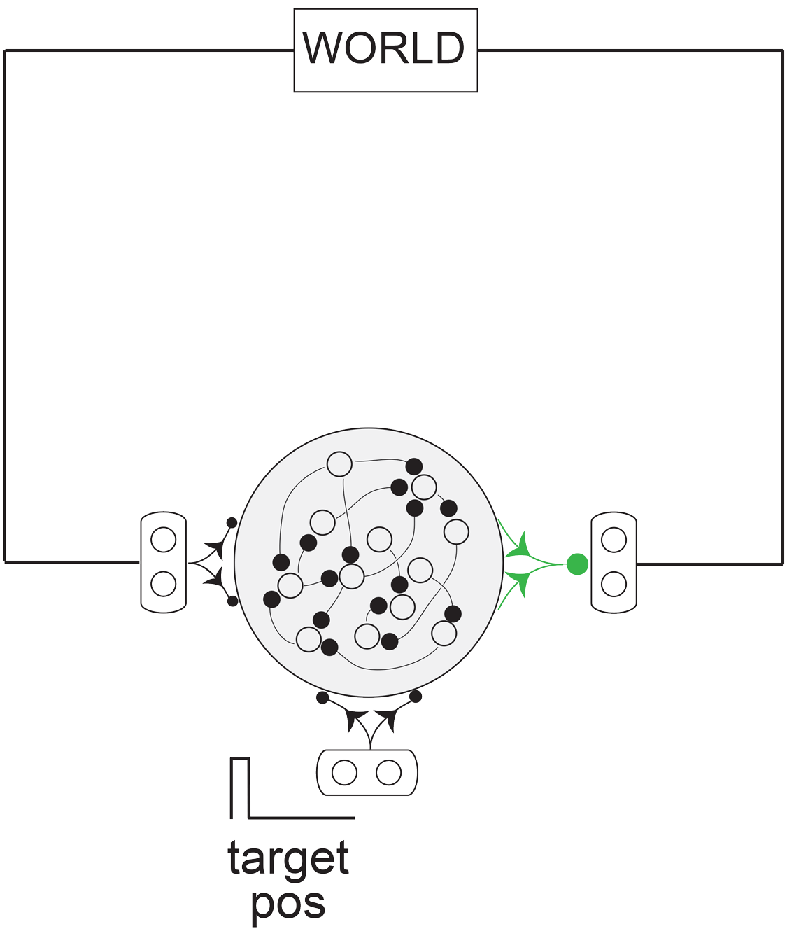
Model

Slide 35
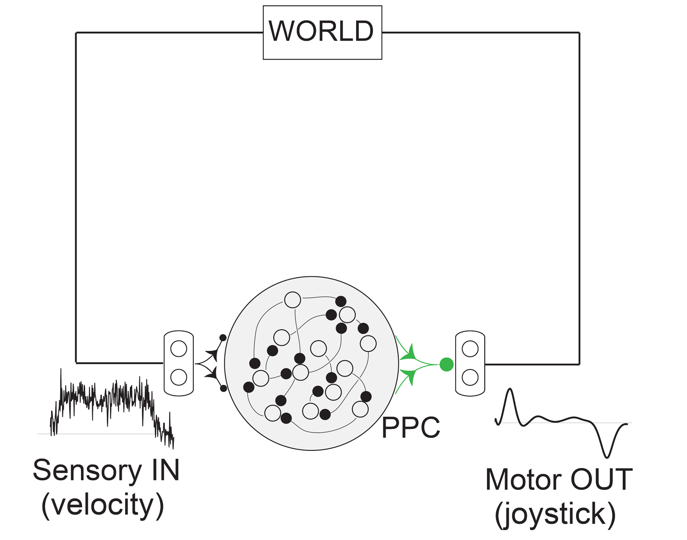
Model
PPC: Posterior Parietal Cortex

Slide 36
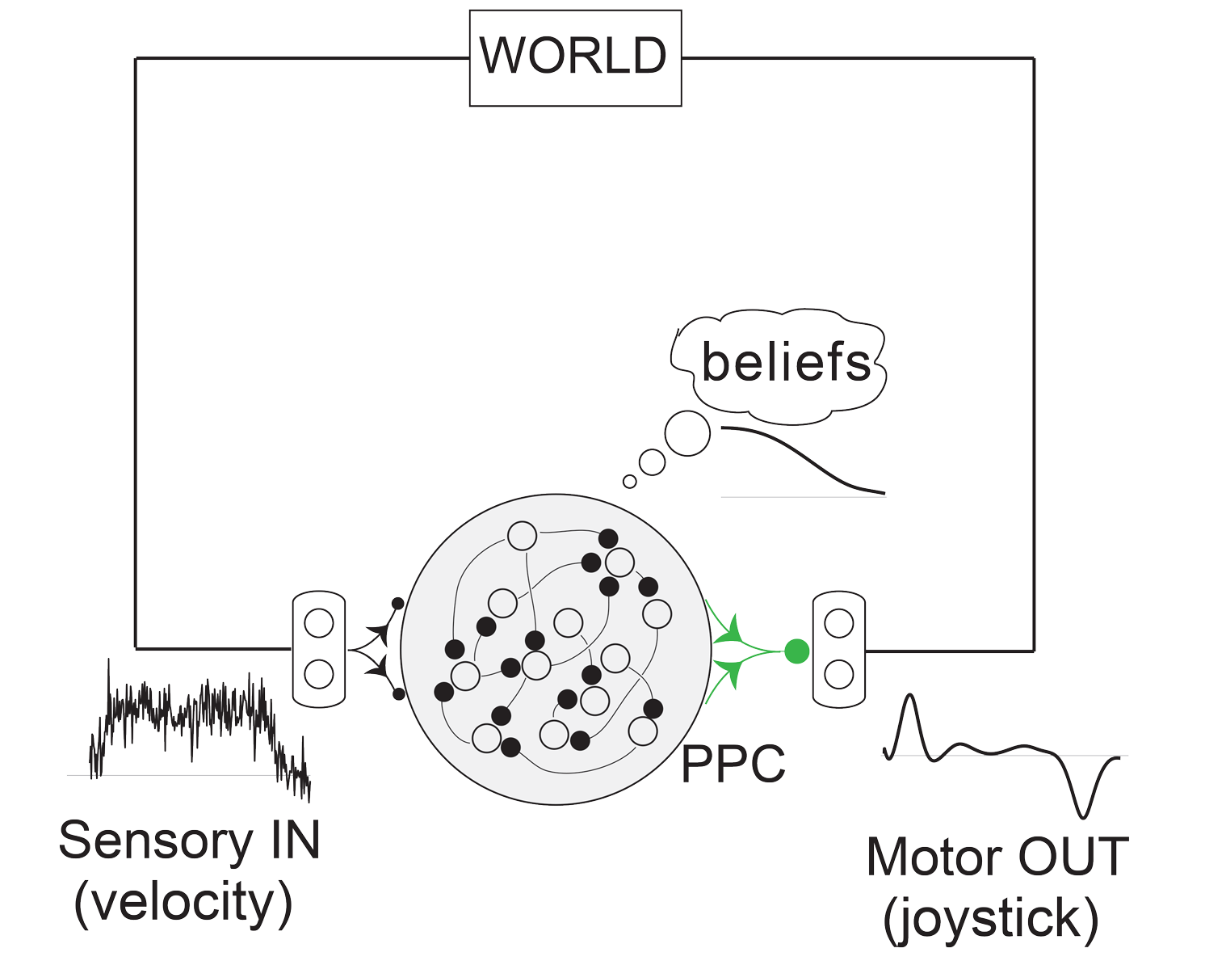
Model
PPC: Posterior Parietal Cortex
Task objective
Notes:
The integration process is thought to take place in the posterior parietal cortex

Slide 37
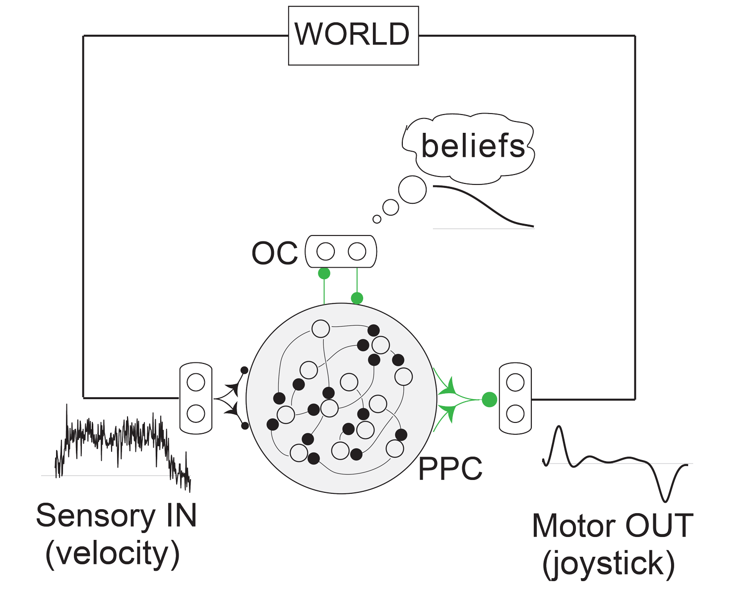
Model
PPC: Posterior Parietal Cortex
Strategy
constraint
OC: Oculomotor Cortex
Task objective

Slide 38
Model
Train connectivity weights shown in green using Backpropagation through time
Strategy
constraint
Task objective

Slide 39
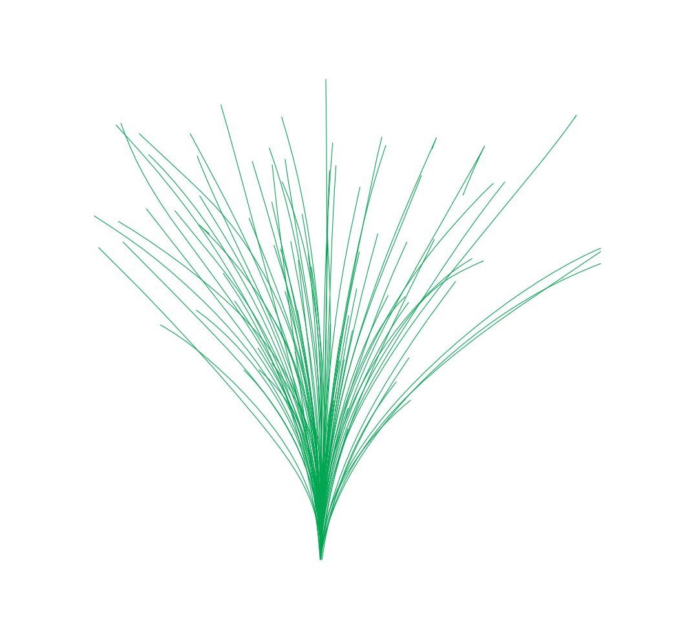
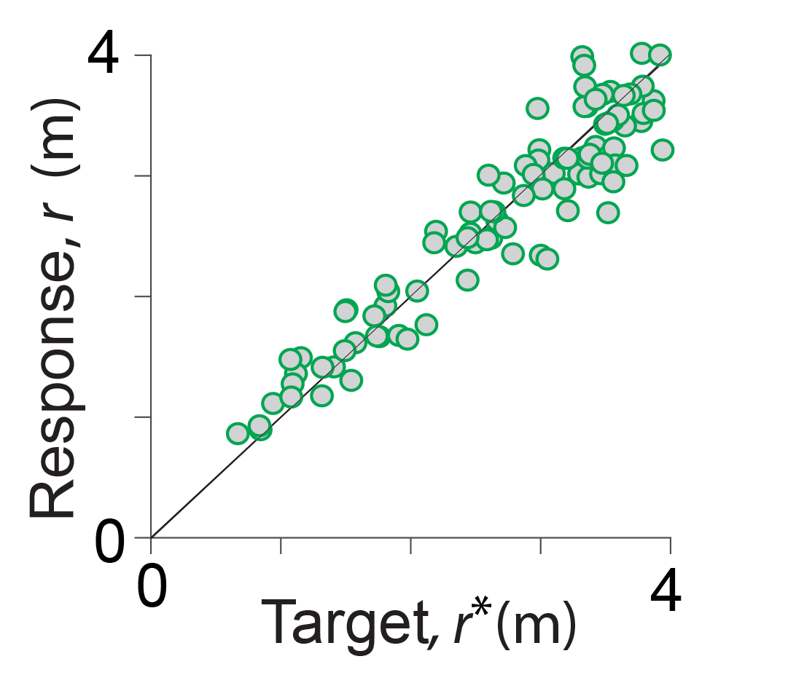
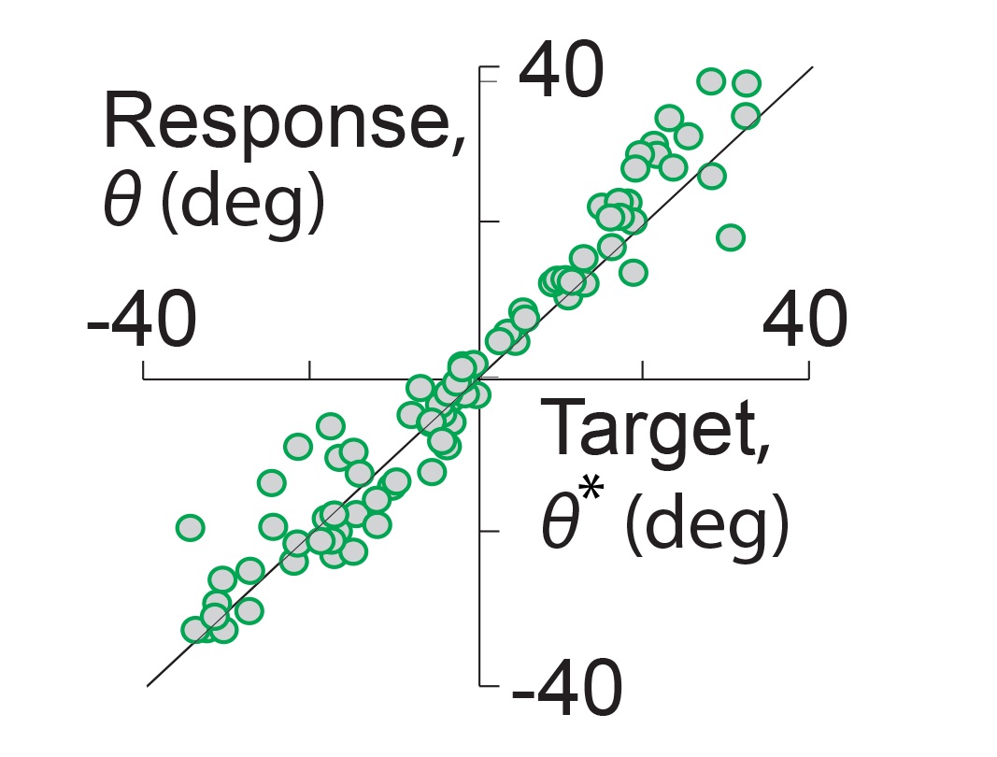
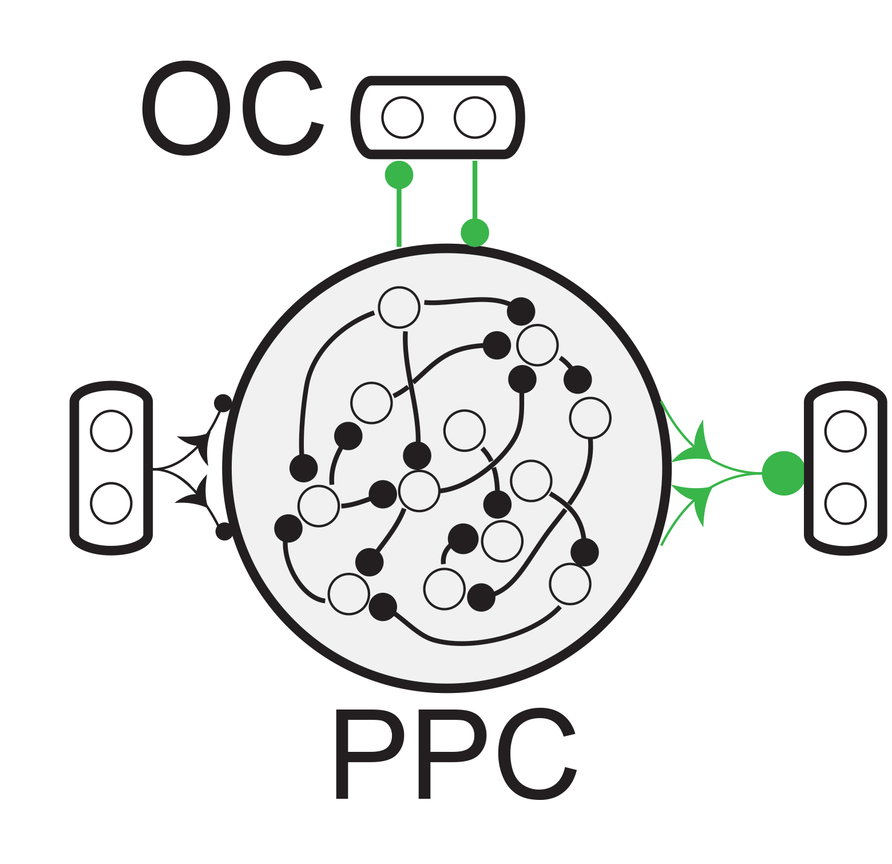
1m
1m

Slide 40
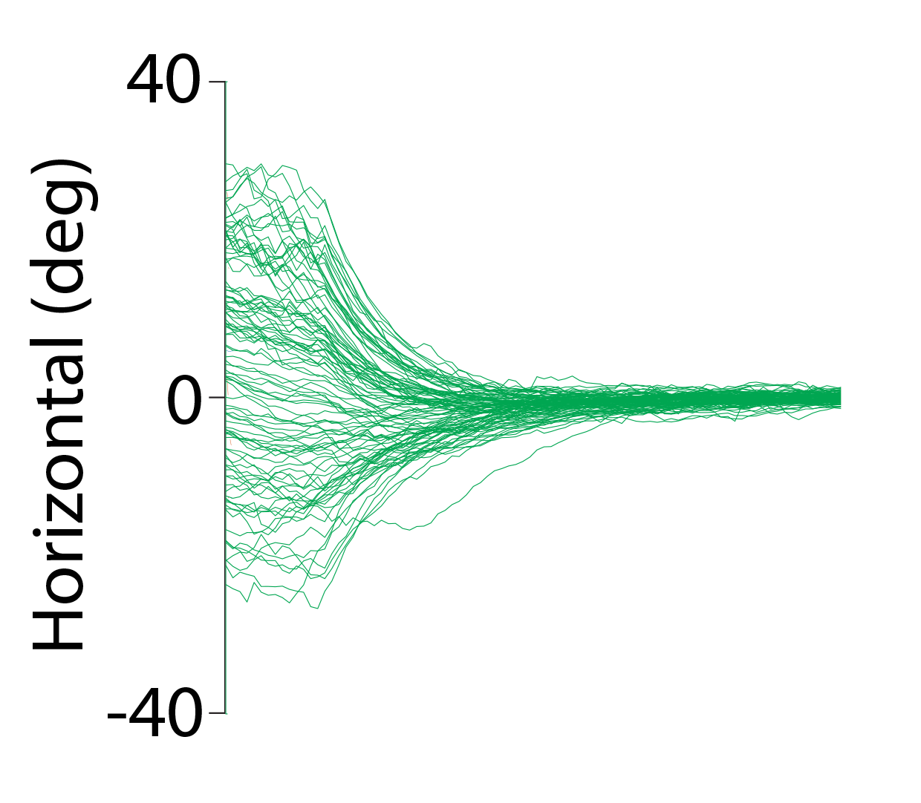
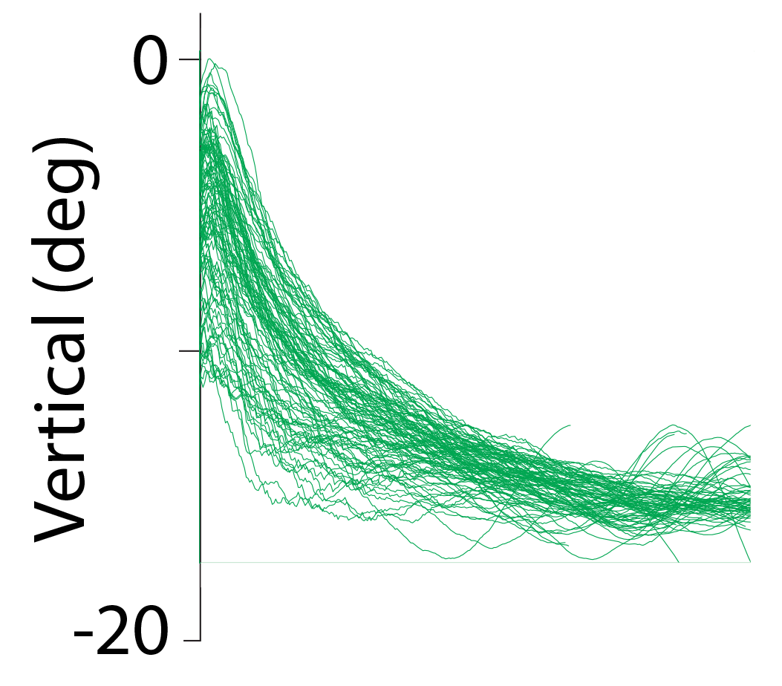
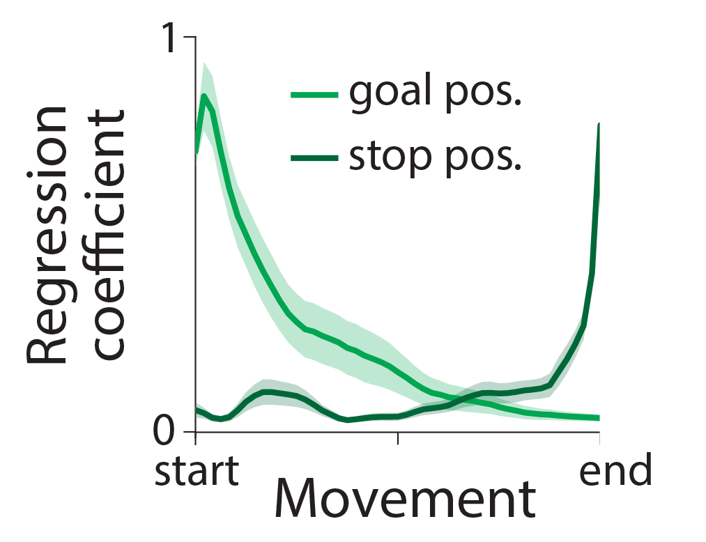

Slide 41
Task performance
✓
✓

Slide 42
Task performance
✓
✓
Embodied
cognition
✓
✓

Slide 43
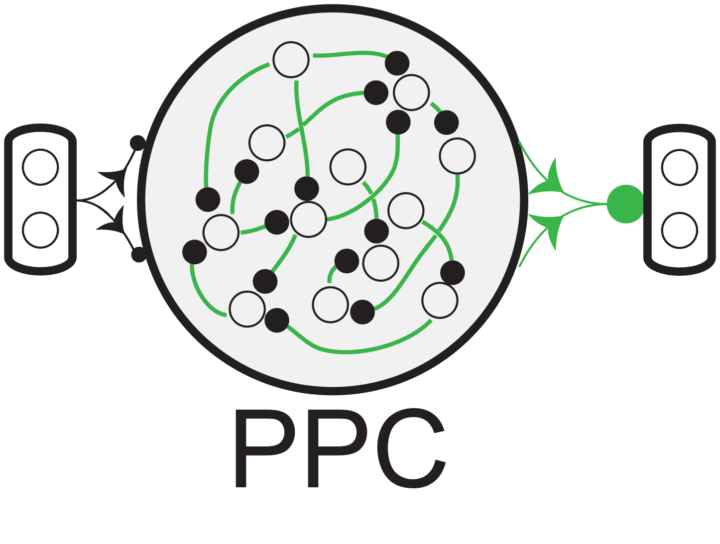
Task-optimized +
strategy-constrained
Task-optimized
Task performance
✓
✓
✓
Embodied
cognition
✓
✓
✗

Slide 44
Task-optimized +
strategy-constrained
Task-optimized
Task performance
✓
✓
✓
Embodied
cognition
✓
✓
✗
Neural
representation
?
?
?
Notes:
Mention somewhere that # parameters is much higher for the failed model

Slide 45
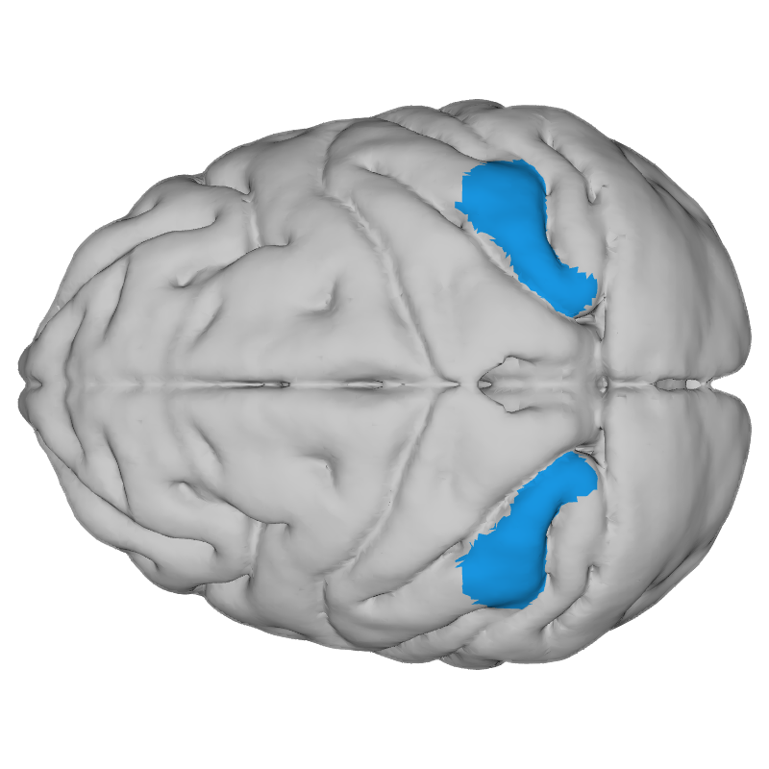
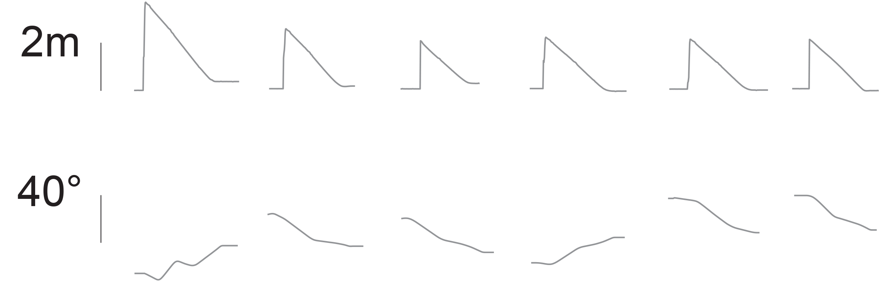
Trials
Anterior
Posterior
1s
D
E
C
O
D
E

Slide 46
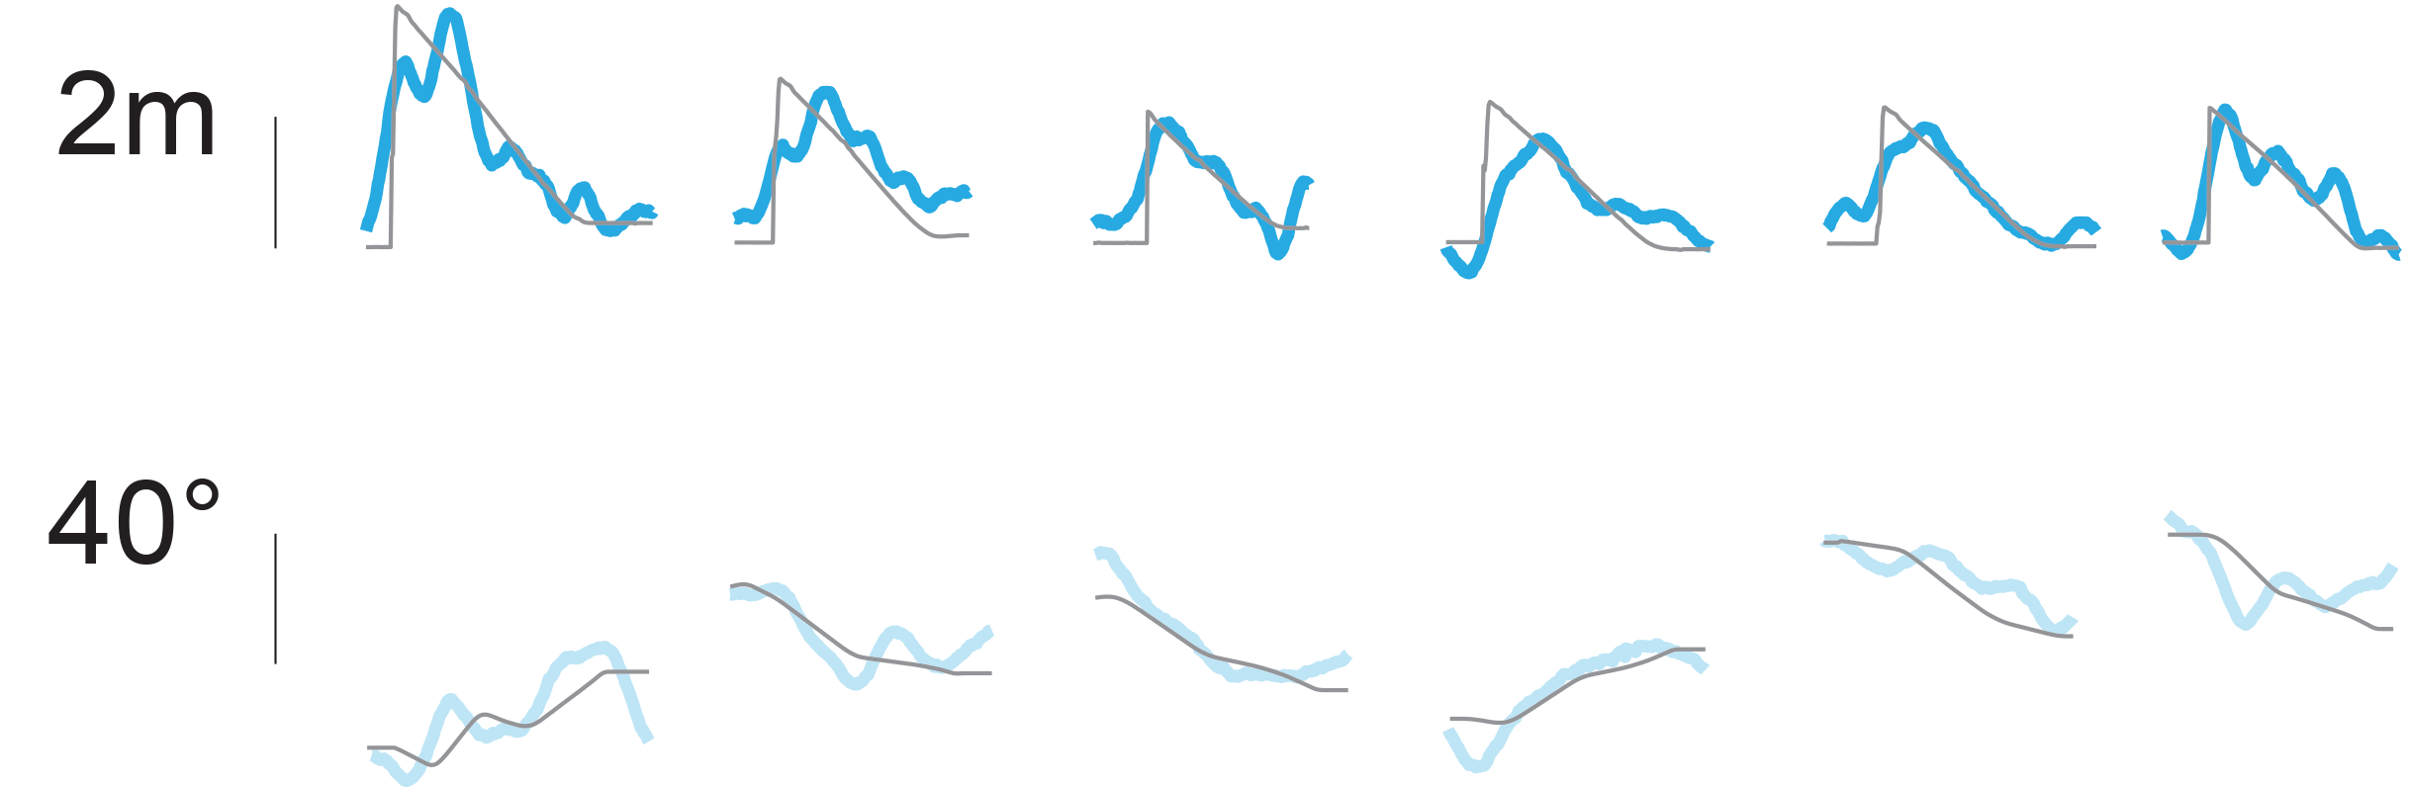
Trials
Anterior
Posterior
1s
D
E
C
O
D
E

Slide 47
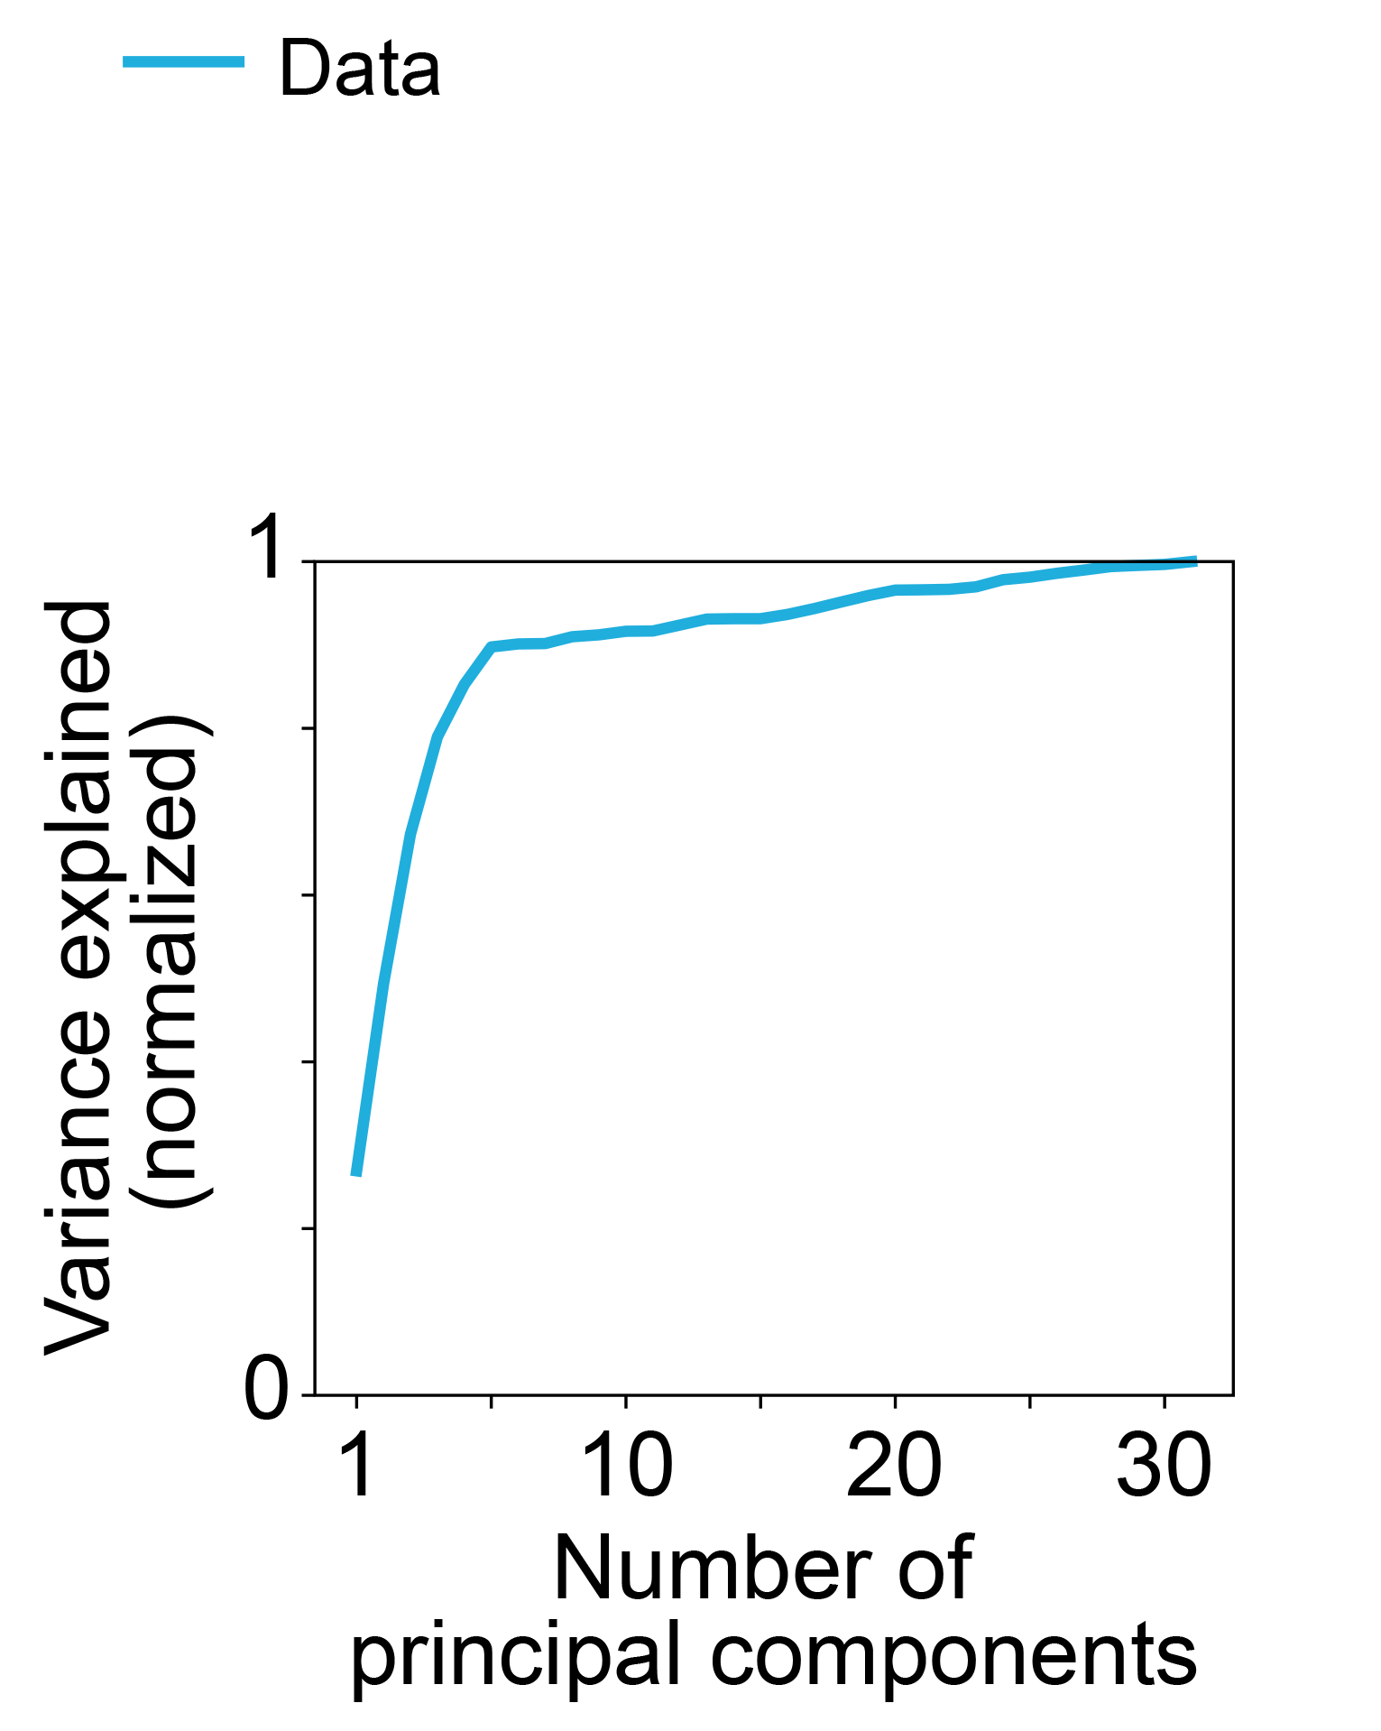

Slide 48
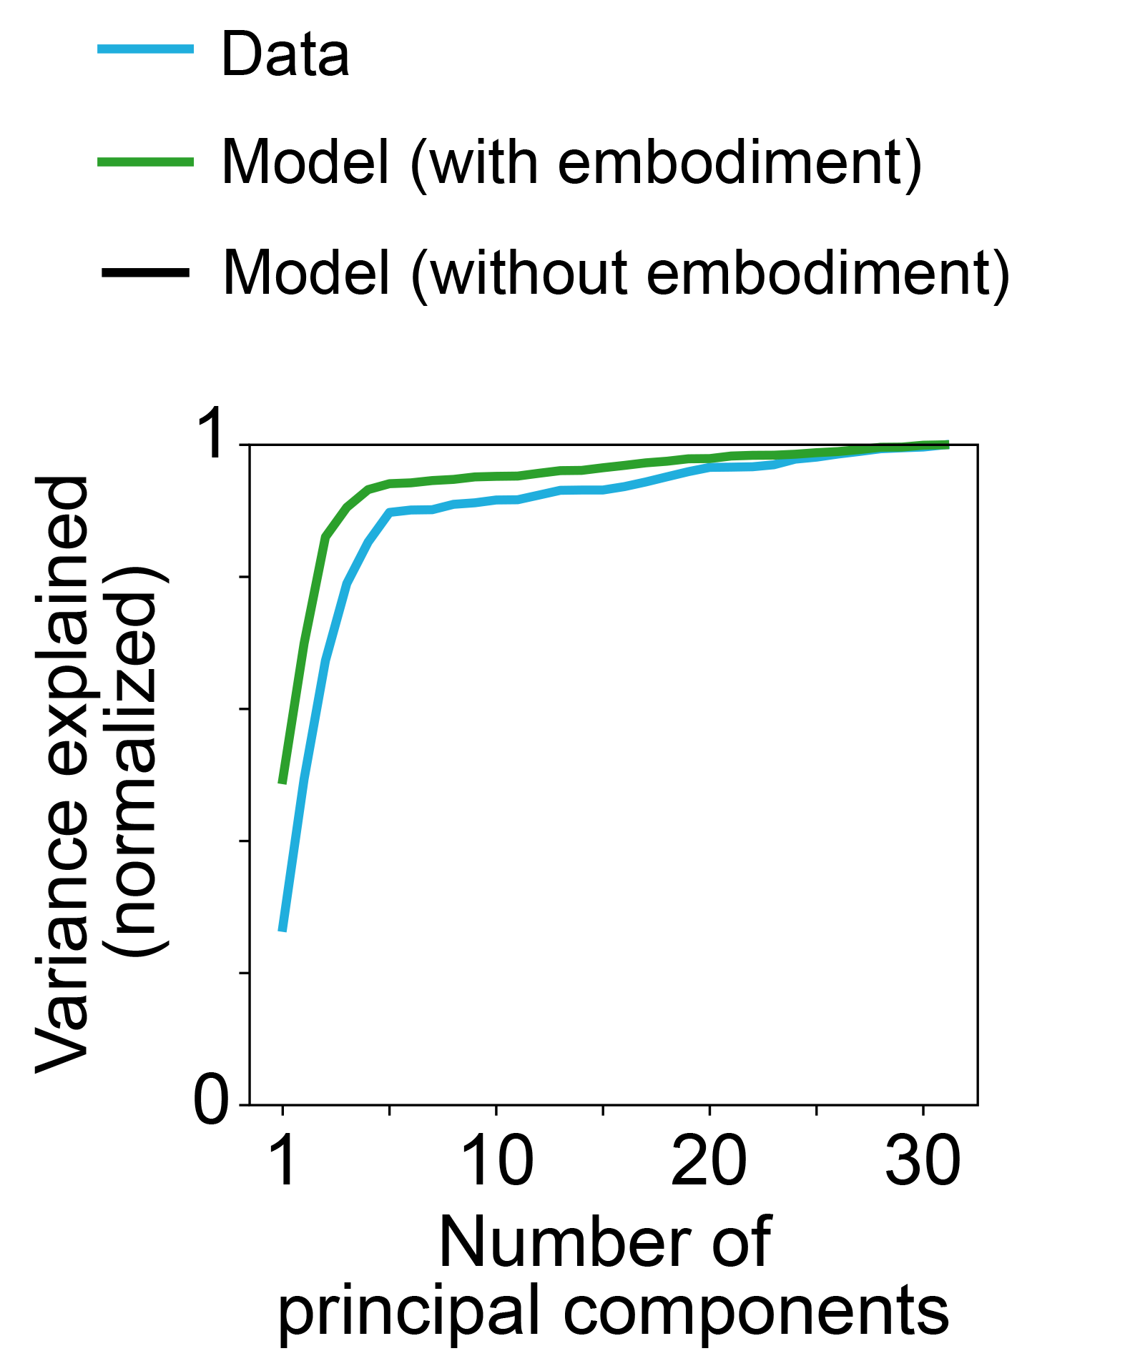
✓
Belief signals are amplified by interactions

Slide 49

✓
✗
Belief signals are amplified by interactions
Belief signals remain buried in low variance modes

Slide 50
Conclusion
To build better computational models of the brain, we must use naturalistic tasks that admit rich behavioral strategies, providing new constraints on how the task must be solved

